Slide 2
Subtitled:
The Amazing Widgets Story
With Special Thanks To
Cloud Services

Slide 3
Who Dis?
Julian Gericke | Solutioneer @ LSD
julian@lsd.co.za
https://lsd.co.za
lsd-information-technology
@lsdcoza

Slide 4
The Amazing Widgets story (like all great startup stories), began in a garage, creating a widget pricing comparison API...
When cheapskate widget-bargain hunters caught on to the service they’d created, demand skyrocketed! TPS blew up! Things went cray!
Unfortunately the monolithic architecture and infrastructure they’d been using presented both scalability and mobility limitations
But all was not lost, for a cloud-nativefying, application modernisation platform was close at hand! Enter...

Slide 5
A modern application management platform that provides a consistent development and operations experience for cloud and on-premises environments, with such features as:
Migrate for Anthos
GKE On-prem
Anthos Service Mesh
Anthos Config Management
Binary Authorization
Migrate your virtualized workloads to containers and deploy to K8!
(Currently supports Linux or Windows VMs running on VMware, AWS, Azure, or Compute Engine)
GKE on-prem is hybrid cloud software that brings GKE to your datacenter
Fully managed service mesh for your complex microservices architectures.
Automate policy and security at scale for your hybrid and multi-cloud Kubernetes deployments.
Deploy only trusted containers on Google Kubernetes Engine.

Slide 6
1. Quickly containerise non-portable legacy backend with Migrate for Anthos!
2. Deploy newly containerised backend service to a local datacenter running Anthos GKE-on-prem!
3. Autoscale! Cater to fluctuating workloads using the power of Kubernetes
?. The devs are decomposing our old monolithic backend API, sit tight...
5. We have microservices! Anthos Service Mesh is leveraged to provide observability and SLO tracking!
Amazing Widgets: The Journey to Cloud Native awesomeness with >>

Slide 7
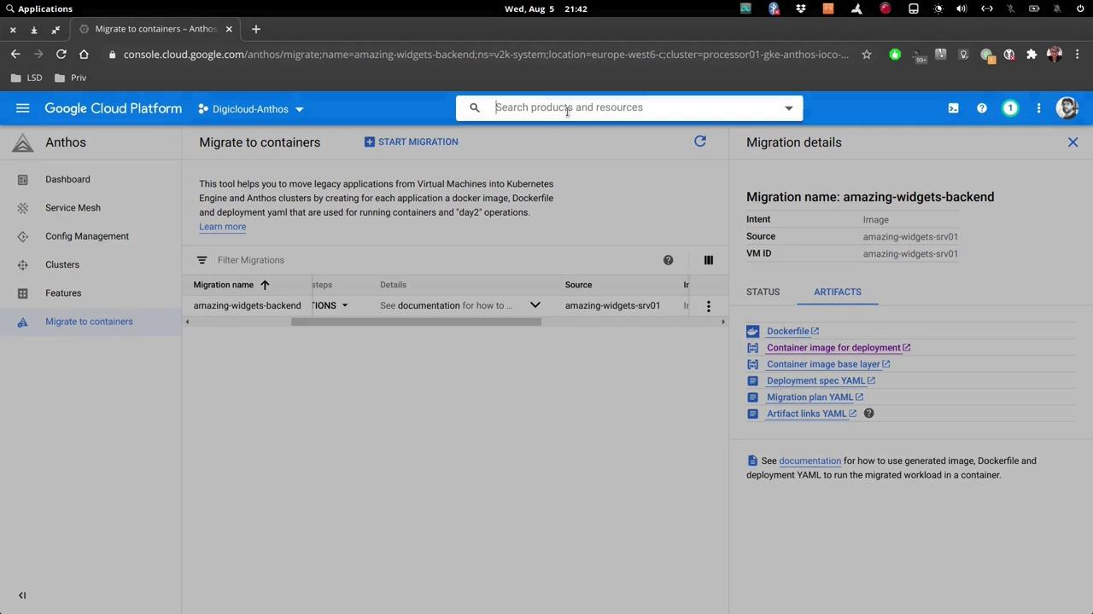
Amazing Widgets: Migrate for

Slide 8
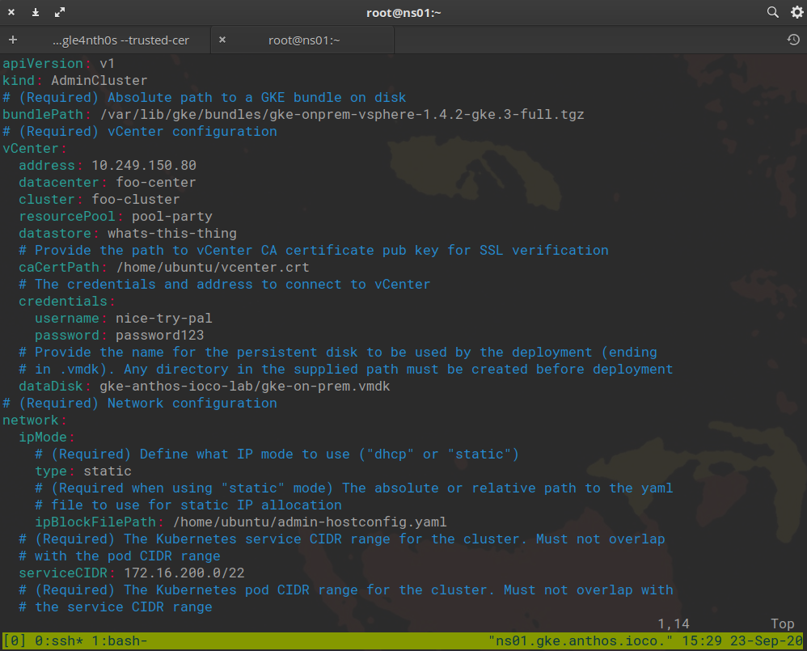
Amazing Widgets: GKE On-prem

Slide 9
Deploy newly containerised monolith to GKE On-Prem (Prod)
***Insert ridiculous typing noises while monolith is decomposed***
Use Anthos Service Mesh to provide observability across newly built microservices!
Amazing Widgets: Journey

